Slide 1
CSE 445 Lecture 12
Decision Tree (Part 1)

Slide 2
Decision tree
Classification and regression trees are machine-learning methods for constructing prediction models from data
The models are obtained by recursively partitioning the data space and fitting a simple prediction model within each partition
As a result, the partitioning can be represented graphically as a decision tree
Classification trees are designed for dependent variables that take a finite number of unordered values, with prediction error measured in terms of misclassification cost
Regression trees are for dependent variables that take continuous or ordered discrete values, with prediction error typically measured by the squared difference between the observed and predicted values

Slide 3
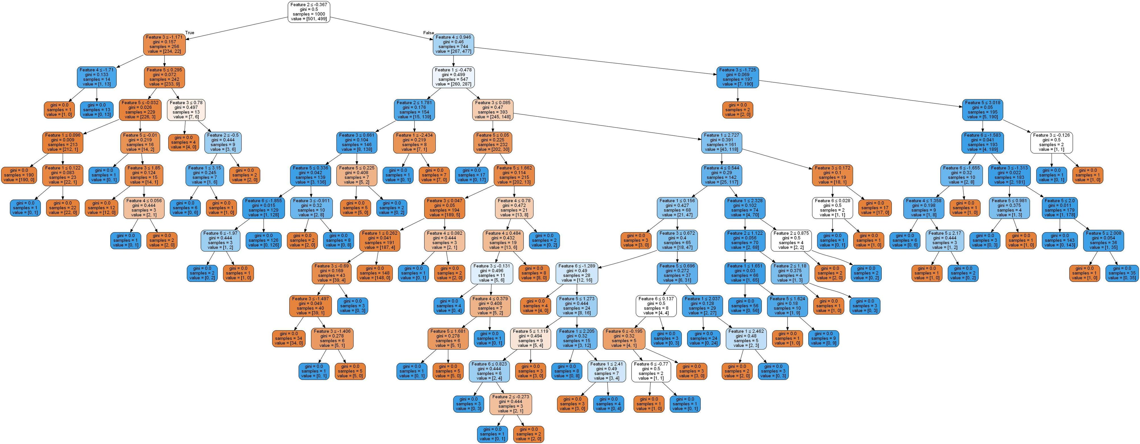
Decision Tree cassifier

Slide 4
Decision tree
In a classification problem, we have a training sample of n observations on a class variable Y that takes values 1, 2, ... , k, and p predictor variables, X1,..., Xp
Our goal is to find a model for predicting the values of Y from new X values
In theory, the solution is simply a partition of the X space into k disjoint sets, A1, A2,..., Ak, such that:
The predicted value of Y is j if X belongs to Aj , for j = 1, 2,..., k
If the X variables take ordered values, two classical solutions are linear discriminant analysis and nearest neighbor classification
These methods yield sets Aj with piecewise linear and nonlinear, respectively, boundaries that are not easy to interpret if p is large

Slide 5
An example
Classification tree methods yield rectangular sets A_{j} by recursively partitioning the data set one X variable at a time
This makes the sets easier to interpret.
The figure on the next slide gives an example wherein there are three classes and two X variables
The left panel plots the data points and partitions and the right panel shows the corresponding decision tree structure
A key advantage of the tree structure is its applicability to any number of variables, whereas the plot on its left is limited to at most two.

Slide 6
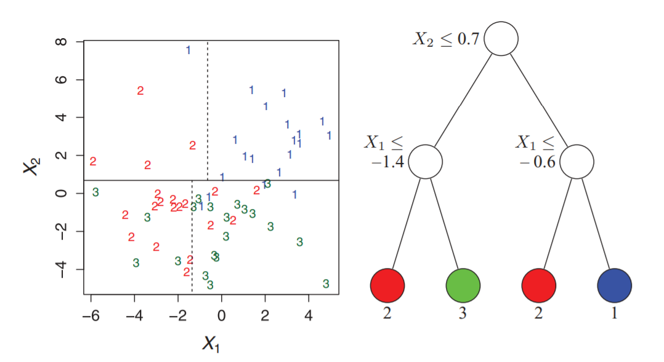
Decision tree example

Slide 7
Decision tree algorithms
Pseudocode for tree construction by exhaustive search
Start at the root node
For each X, find the set S that minimizes the sum of the node impurities in the two child nodes and choose the split {X∗ ∈ S∗} that gives the minimum overall X and S
If a stopping criterion is reached, exit. Otherwise, apply step 2 to each child node in turn
In high level English words in the next slide

Slide 8
Decision tree
We start at the root and split the data based on the features
We repeat this splitting procedure at each child node until the leaves are pure
This means that the training examples at each node all belong to the same class
In practice, this can result in a very deep tree with many nodes, which can easily lead to overfitting
We typically want to prune the tree by setting a limit for the maximal depth of the tree

Slide 9
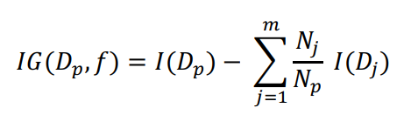
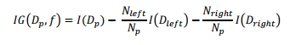
Cost function (Objective function)
The IG is simply the difference between the impurity of the parent node and the sum of the child node impurities
The lower the impurities of the child nodes, the larger the information gain
To keep the solution tractable, that is to reduce the combinatorial search space, most implementations use binary decision trees
In that case, the above IG formula transform to the following

Slide 10
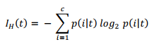
Impurity measurement: Entropy
Here p(i|t) – the proportion of the examples that belong to class i for a particular node t
The entropy is 0 if all examples at a node belong to the same class
The entropy is maximal if we have uniform class distribution
In a binary class setting, the entropy is 0 if 𝑝(𝑖 = 1|𝑡) = 1 or 𝑝(𝑖 = 0|𝑡) = 0
If the classes are distributed uniformly with 𝑝(𝑖 = 1|𝑡) = 0.5 and 𝑝(𝑖 = 0|𝑡) = 0.5, the entropy is 1
Therefore, we can say that the entropy criterion attempts to maximize the mutual information in the tree

Slide 11
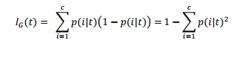
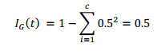
Impurity measurement: Gini impurity
It tries to minimize the probability of misclassification
Gini impurity is maximal if the classes have equal probabilities
For example, in a binary class setting
However in practice Gini impurity and entropy performs almost the same

Slide 12
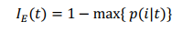
Impurity measurement: Classification error
It looks promising
But it is manly used for pruning the tree for building the tree
The main issue - it is less sensitive to the class probabilities of the nodes

Slide 13
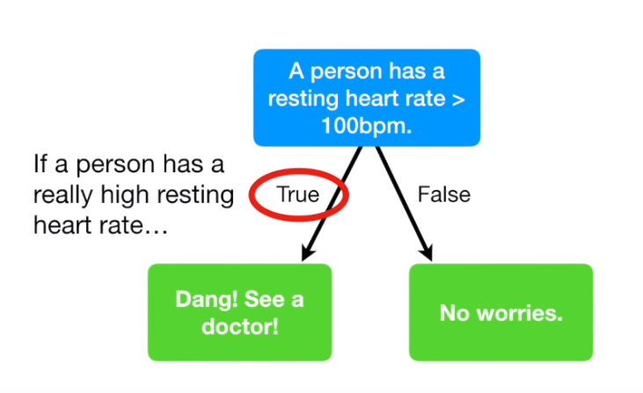
Building a Decision Tree

Slide 14
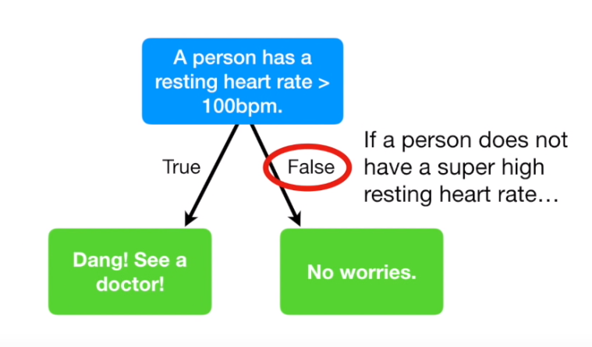
Building a Decision Tree

Slide 15
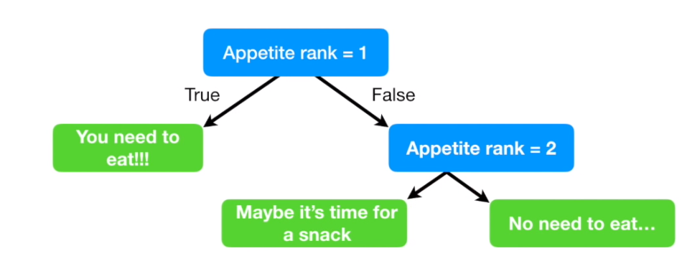
Building a Decision Tree

Slide 16
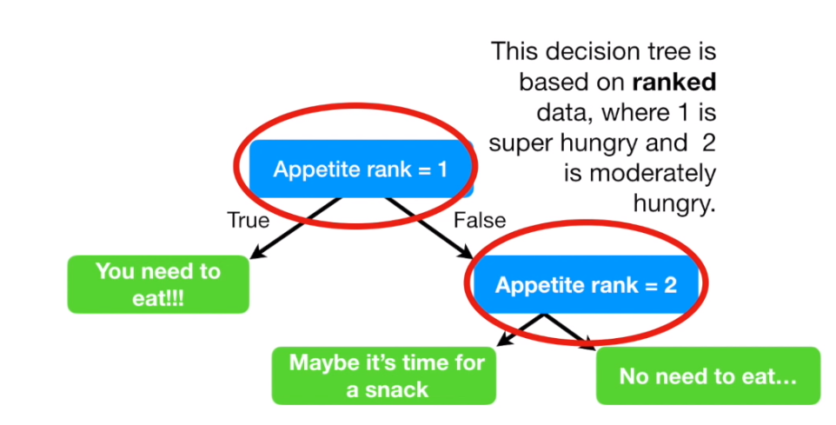
Building a Decision Tree

Slide 17
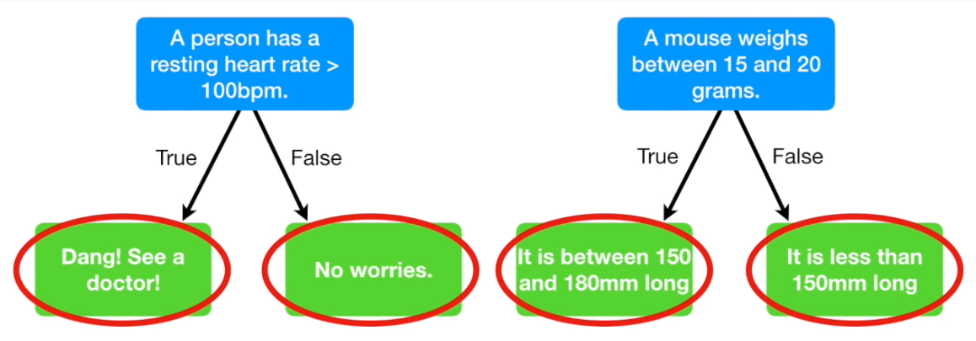
Building a Decision Tree

Slide 18
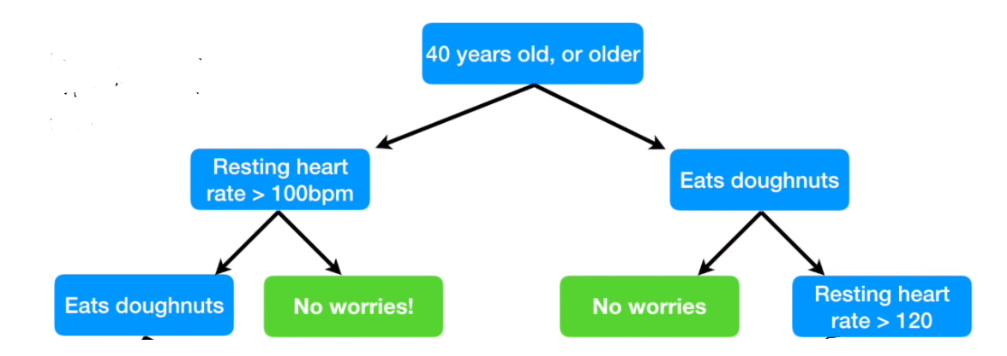
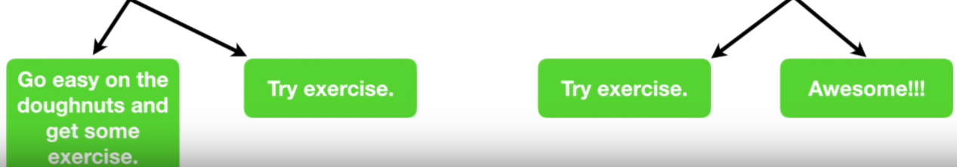
Building a Decision Tree

Slide 19
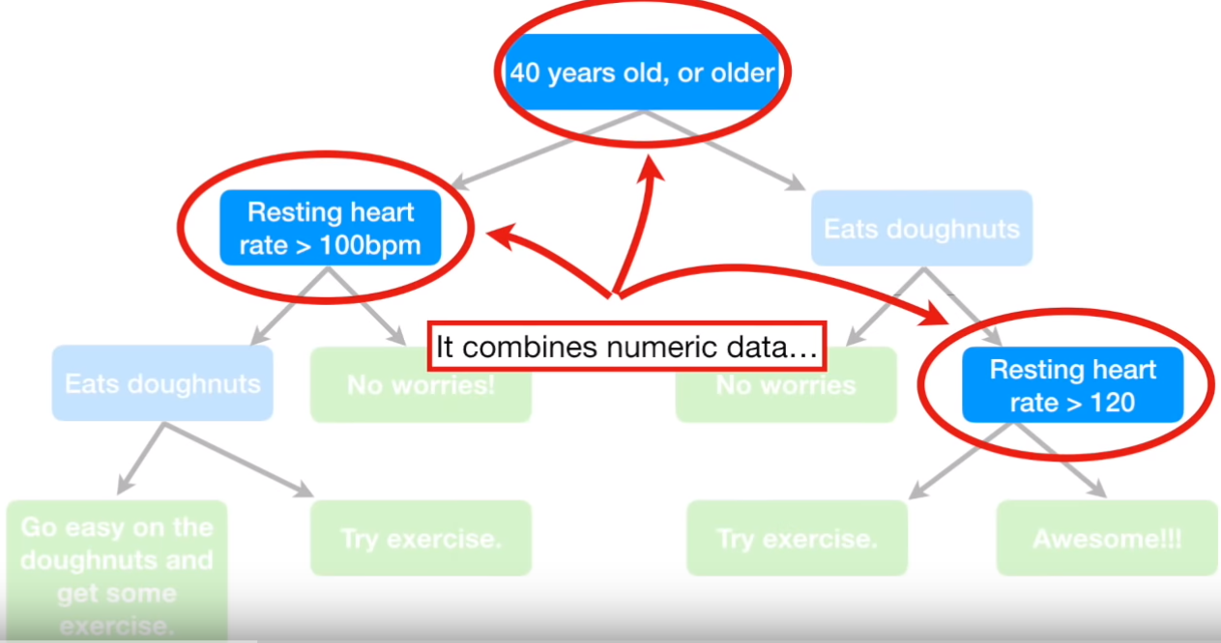
Building a Decision Tree

Slide 20
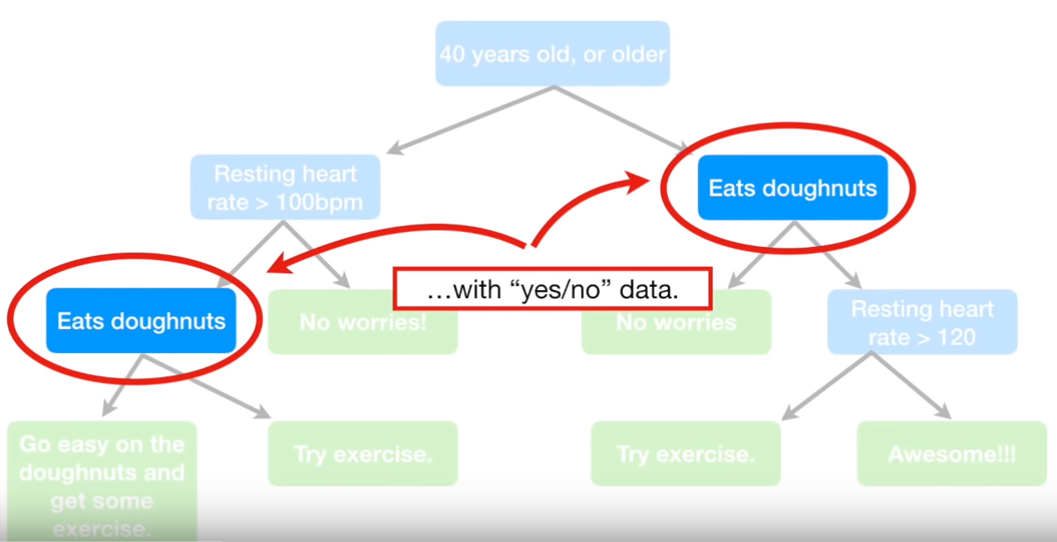
Building a Decision Tree

Slide 21
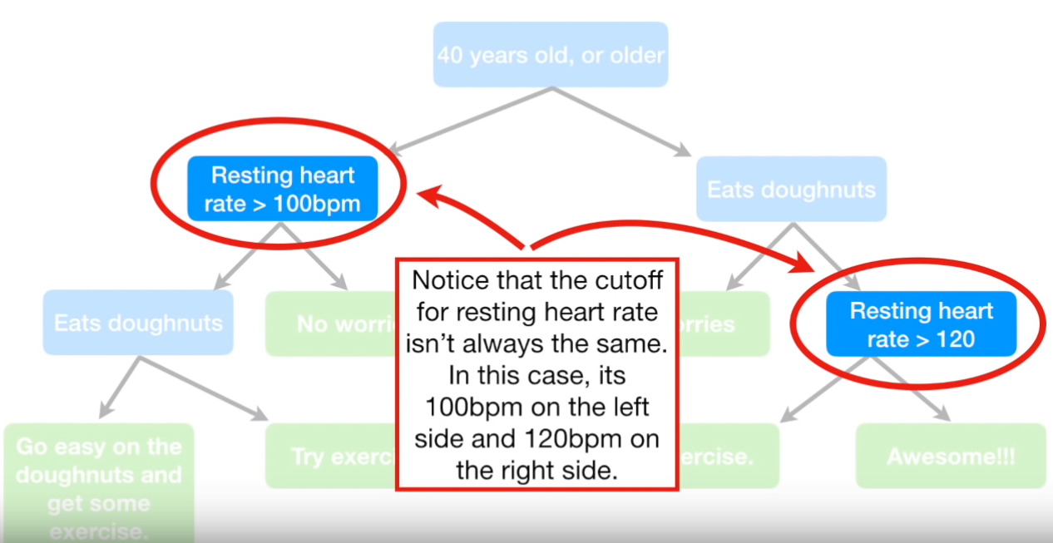
Building a Decision Tree

Slide 22
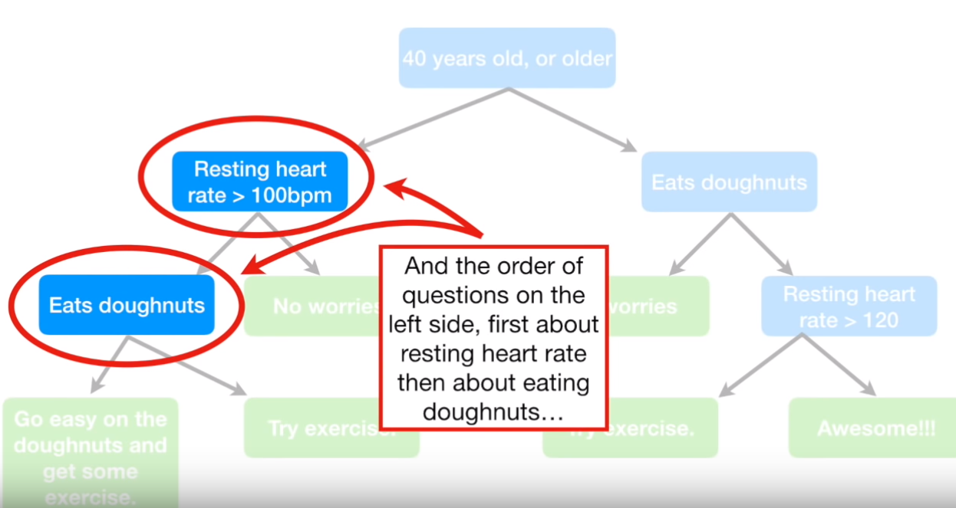
Building a Decision Tree

Slide 23
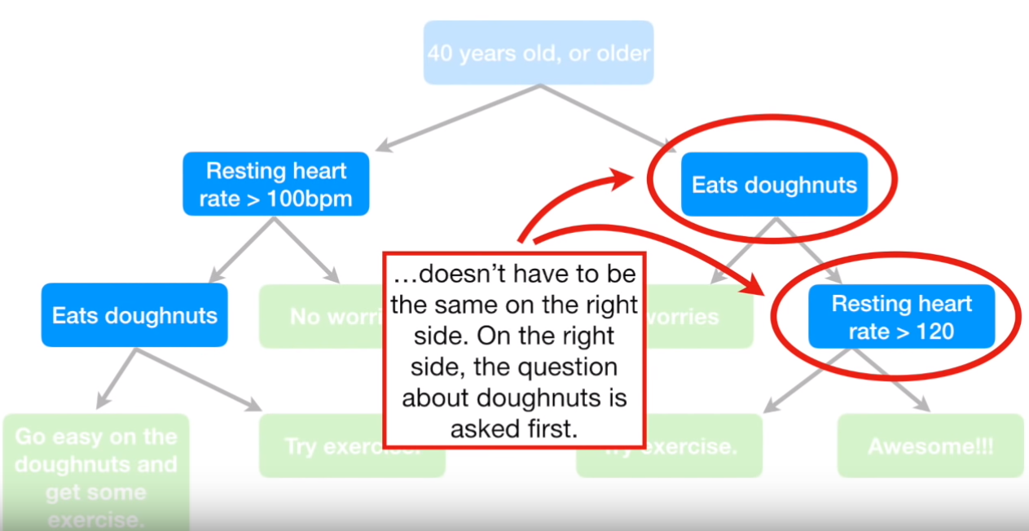
Building a Decision Tree

Slide 24
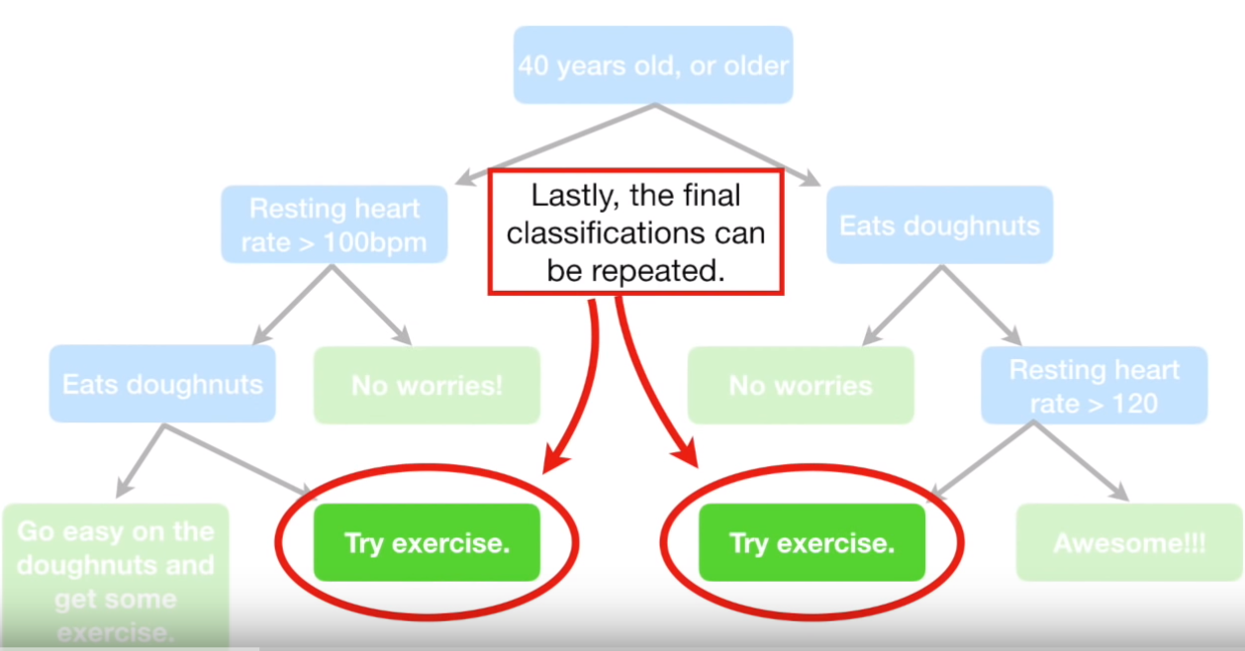
Building a Decision Tree

Slide 25
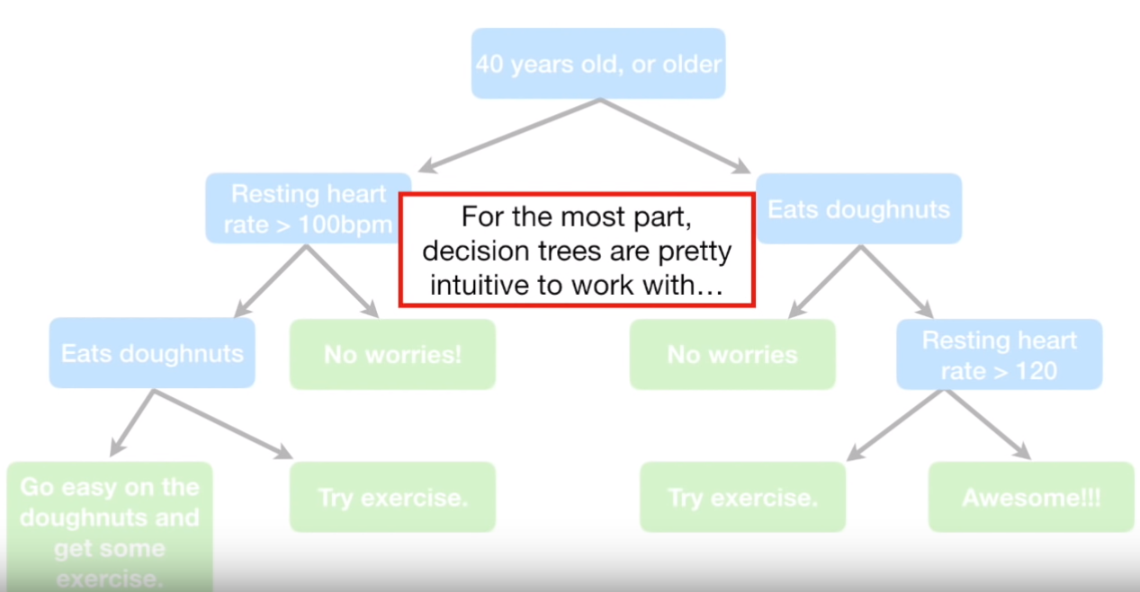
Building a Decision Tree

Slide 26
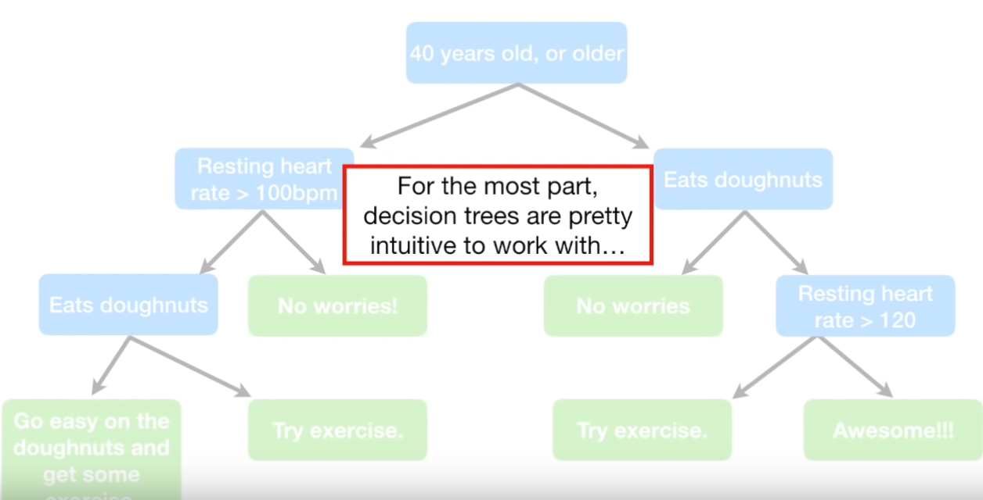
Building a Decision Tree

Slide 27
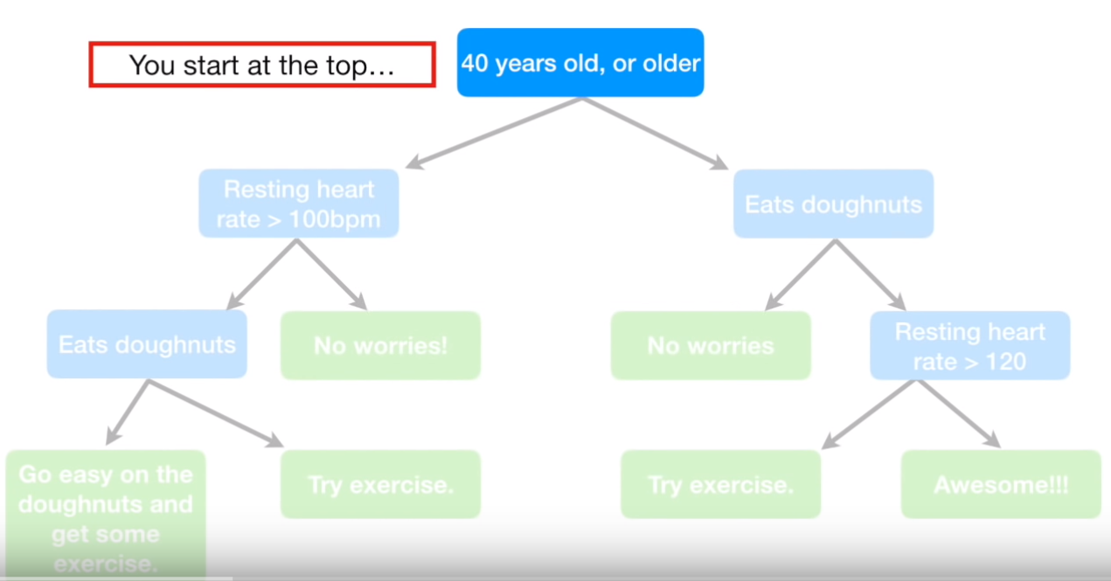
Building a Decision Tree

Slide 28
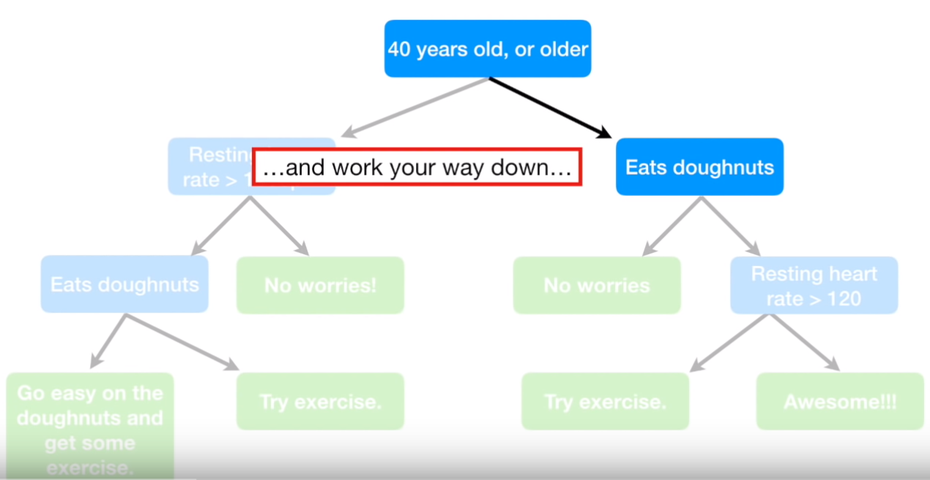
Building a Decision Tree

Slide 29
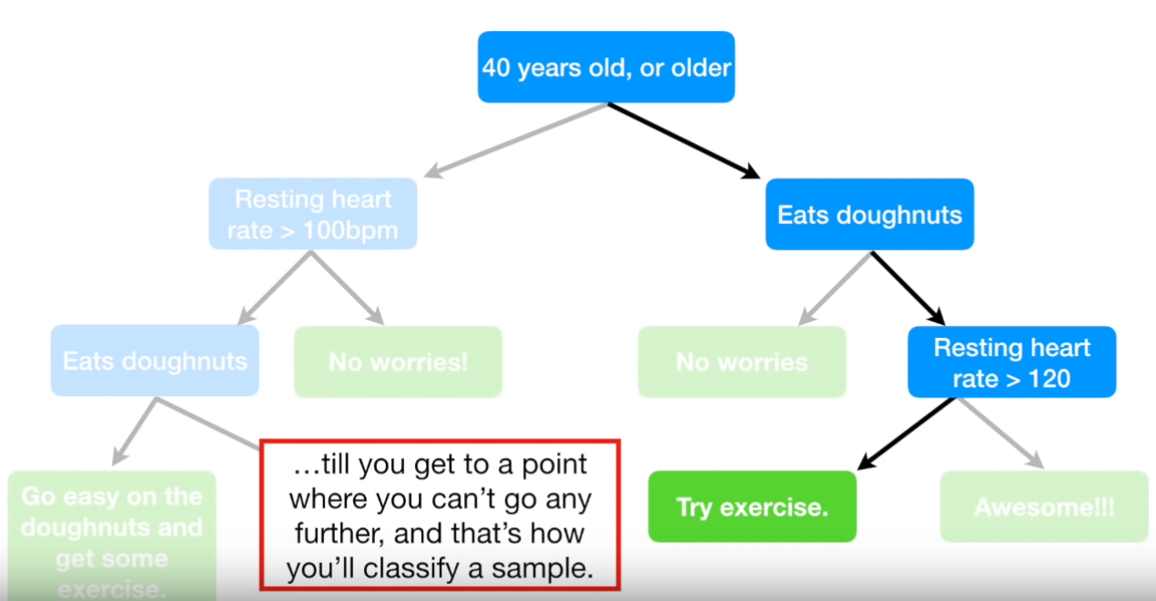
Building a Decision Tree

Slide 30
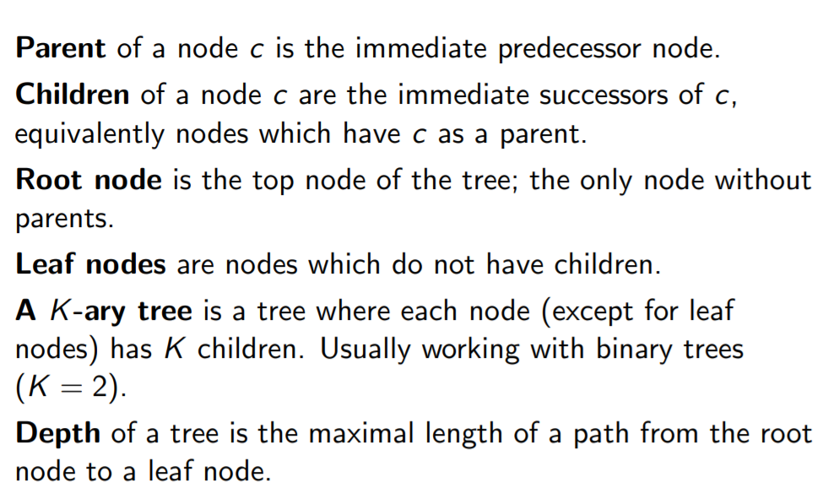
Building a Decision Tree

Slide 31
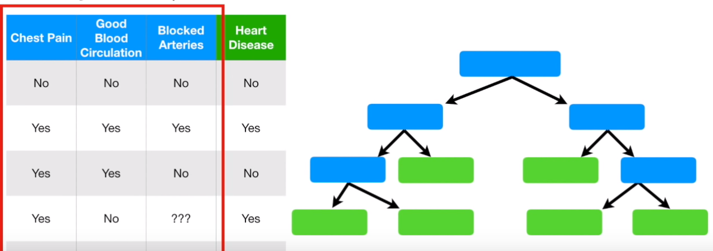
Building a Decision Tree

Slide 32
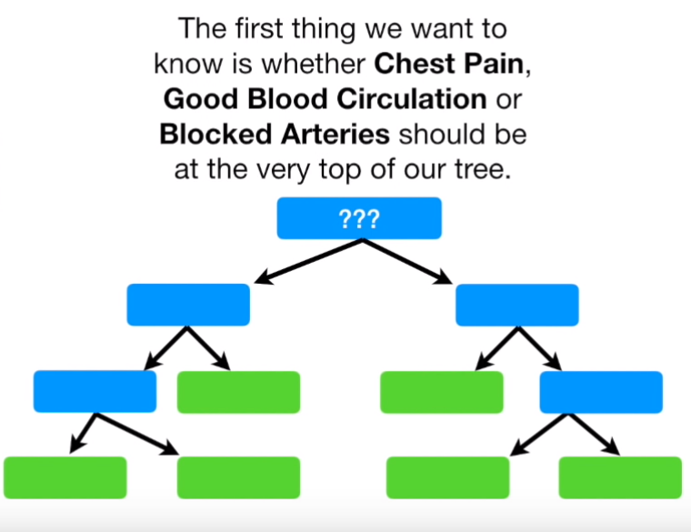
Building a Decision Tree

Slide 33
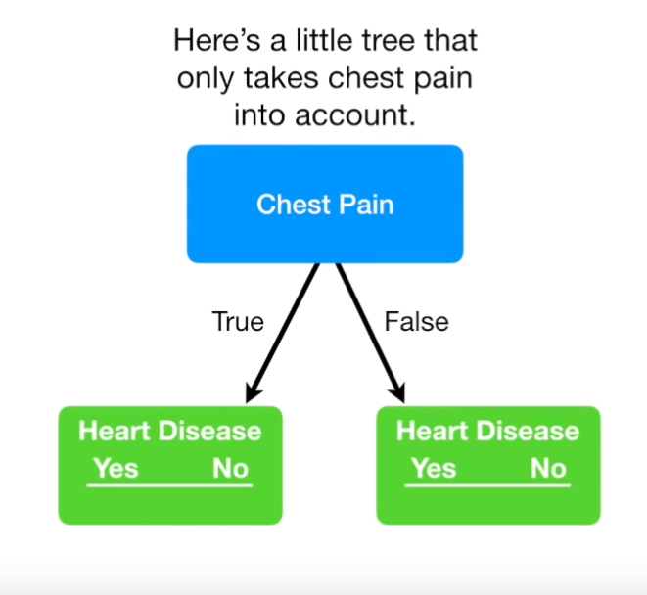
Building a Decision Tree

Slide 34
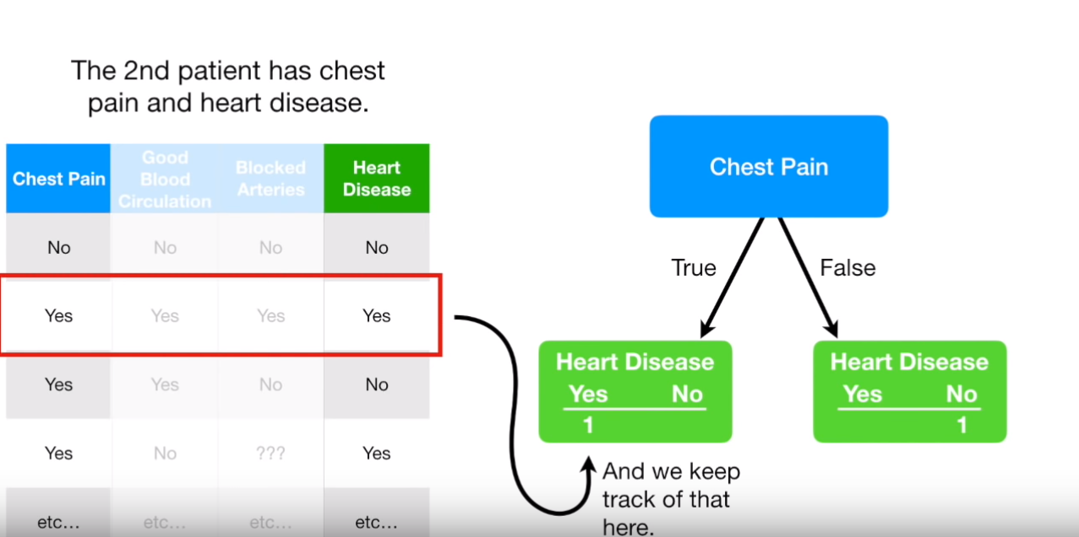
Building a Decision Tree

Slide 35
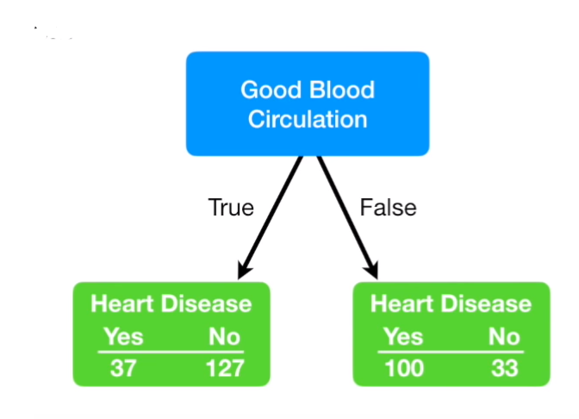
Building a Decision Tree

Slide 36
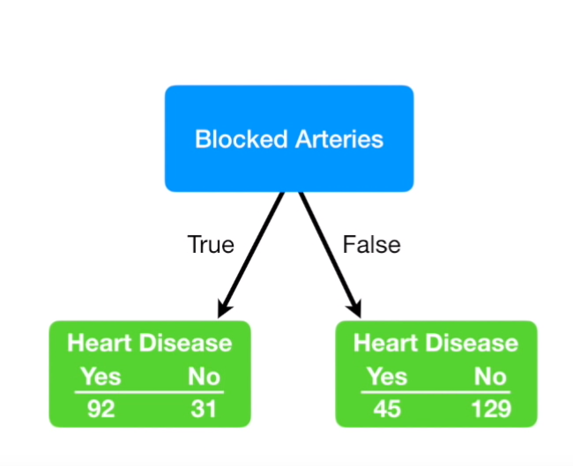
Building a Decision Tree

Slide 37
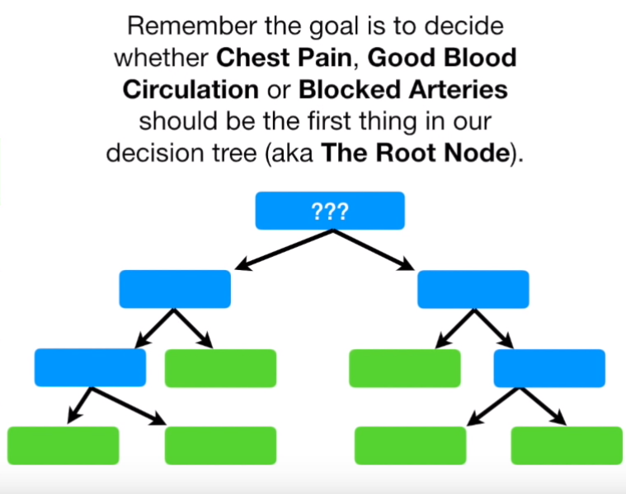
Building a Decision Tree

Slide 38
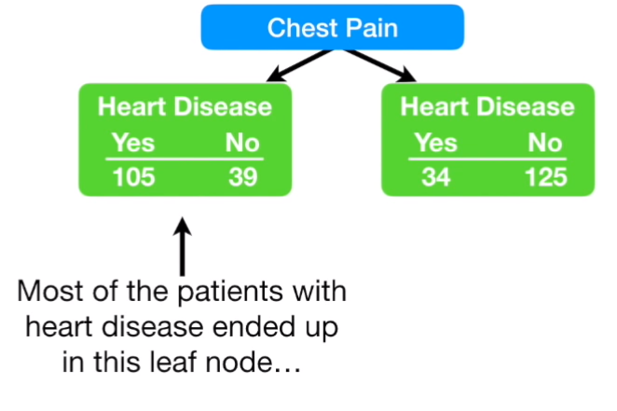
Building a Decision Tree

Slide 39
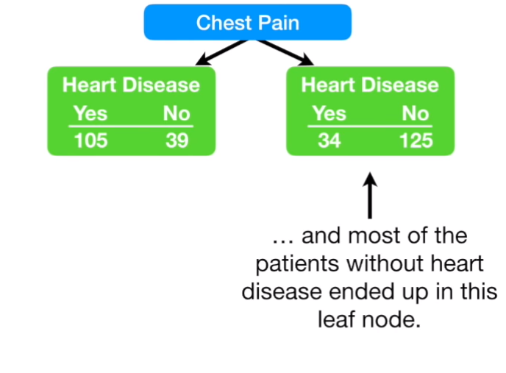
Building a Decision Tree

Slide 40
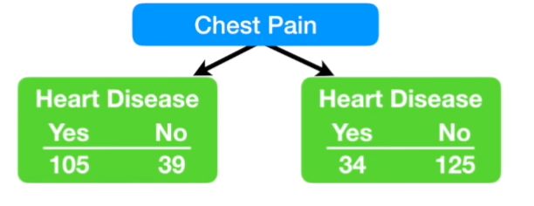
Building a Decision Tree

Slide 41
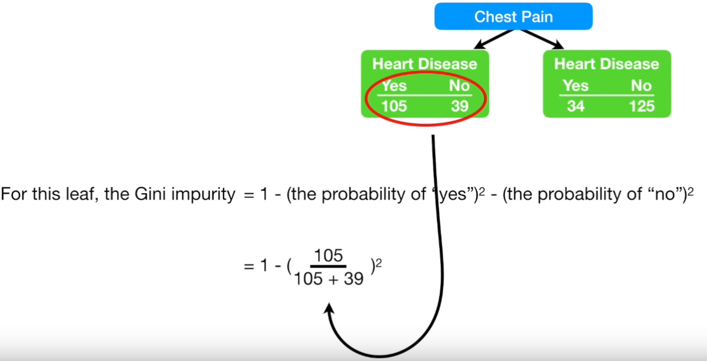
Building a Decision Tree

Slide 42
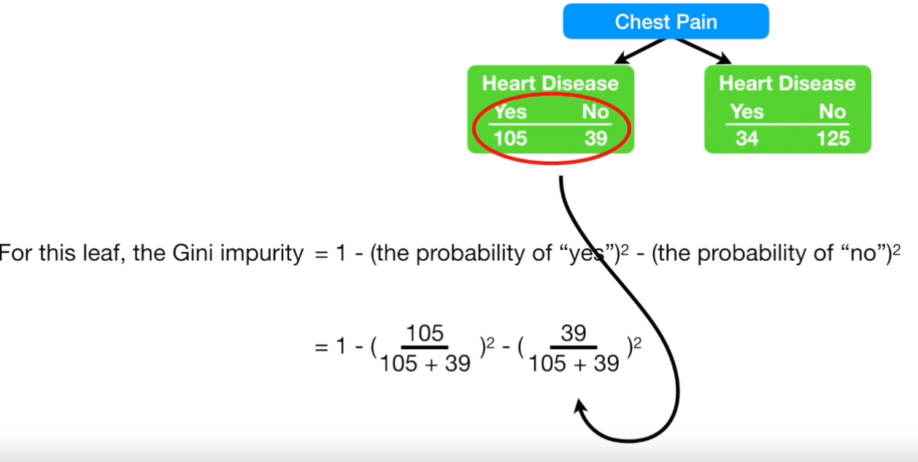
Building a Decision Tree

Slide 43
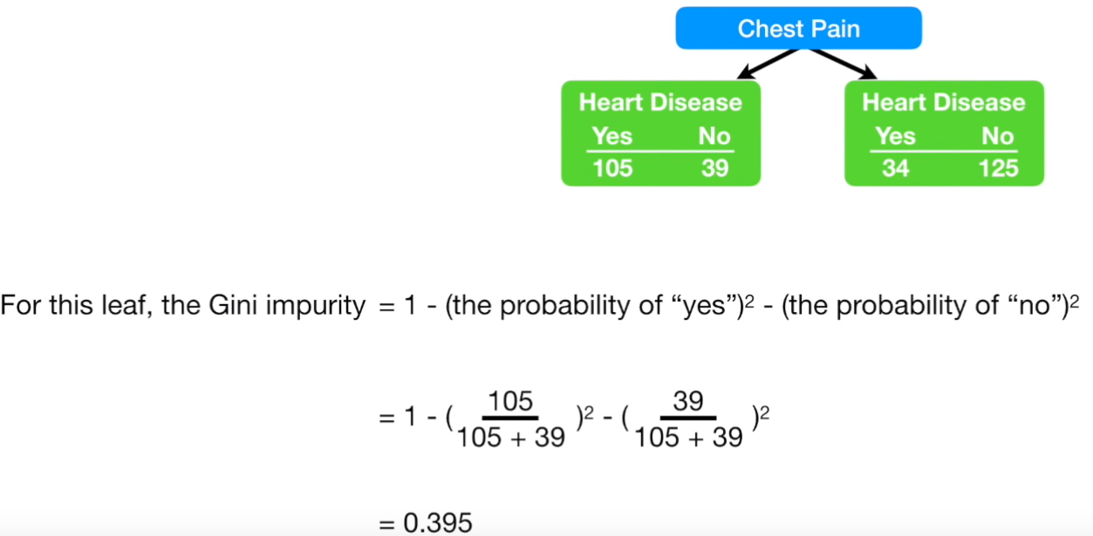
Building a Decision Tree

Slide 44
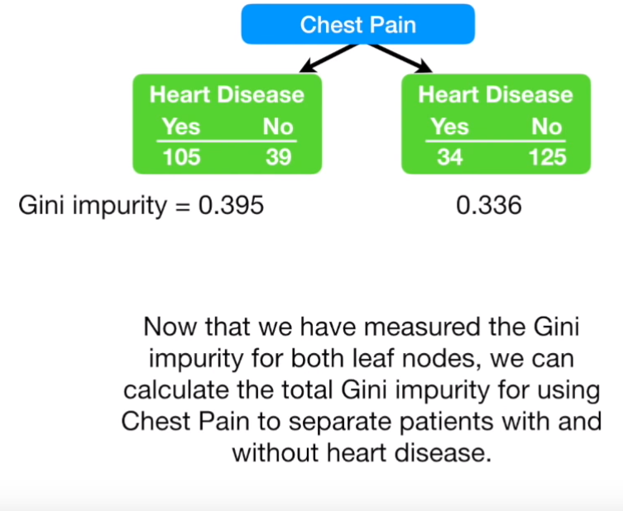
Building a Decision Tree

Slide 45
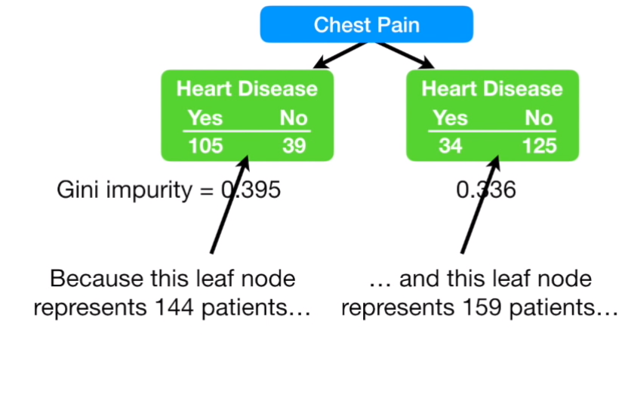
Building a Decision Tree

Slide 46
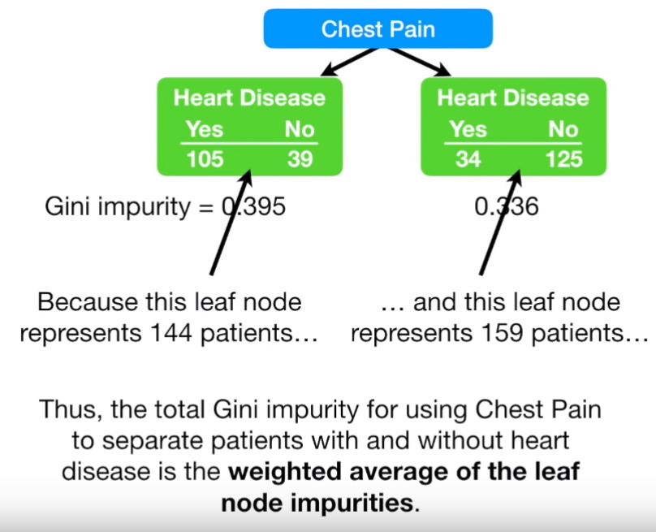
Building a Decision Tree

Slide 47
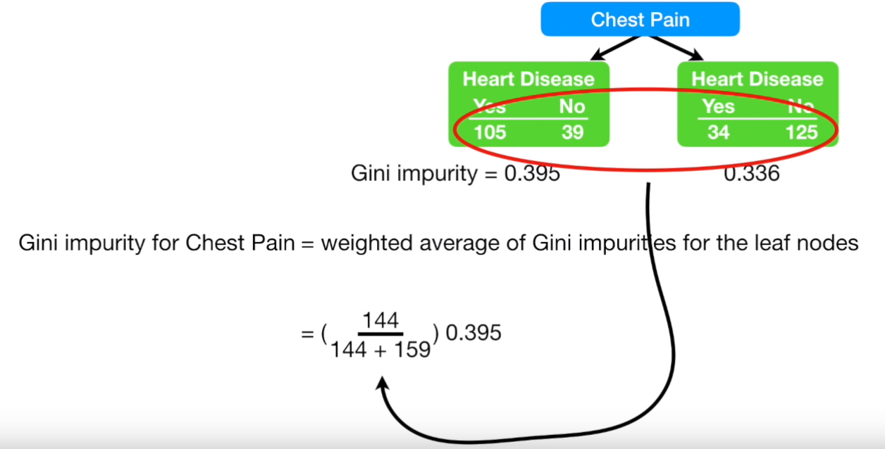
Building a Decision Tree

Slide 48
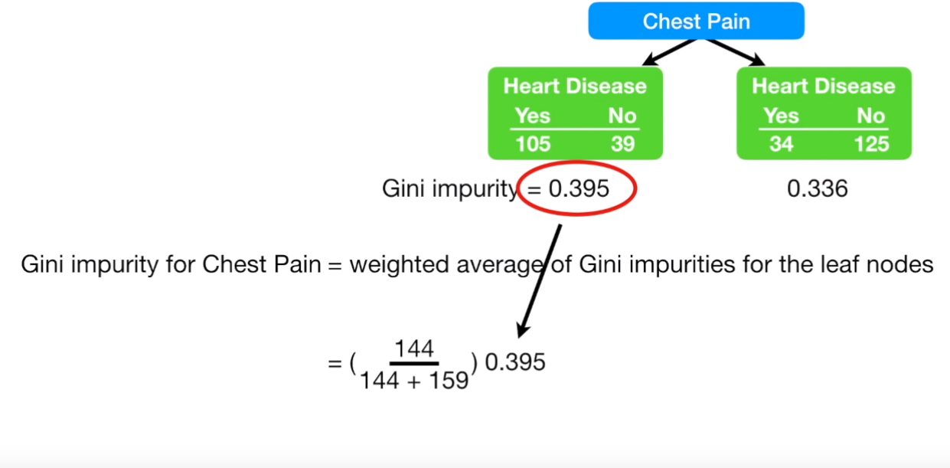
Building a Decision Tree

Slide 49
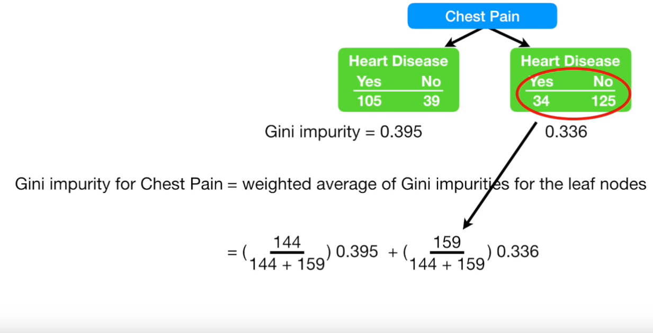
Building a Decision Tree

Slide 50
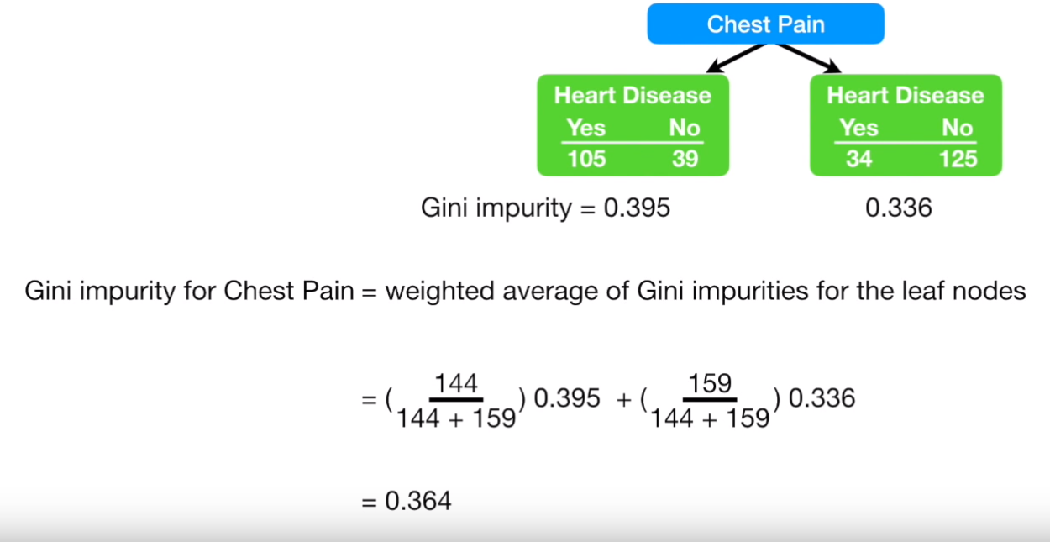
Building a Decision Tree

Slide 51
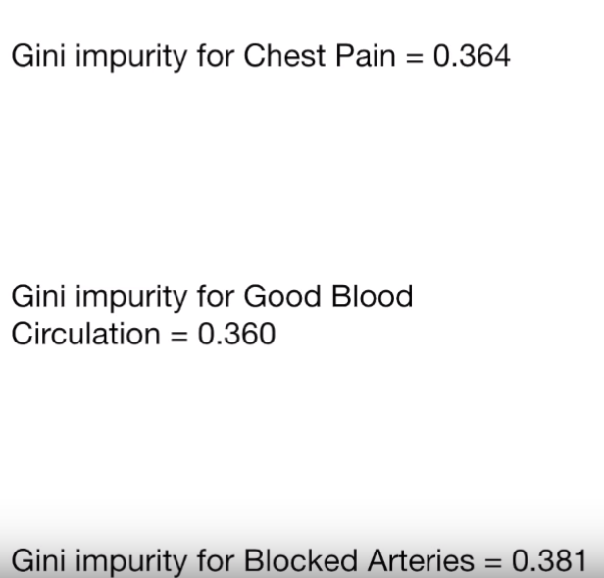
Building a Decision Tree

Slide 52
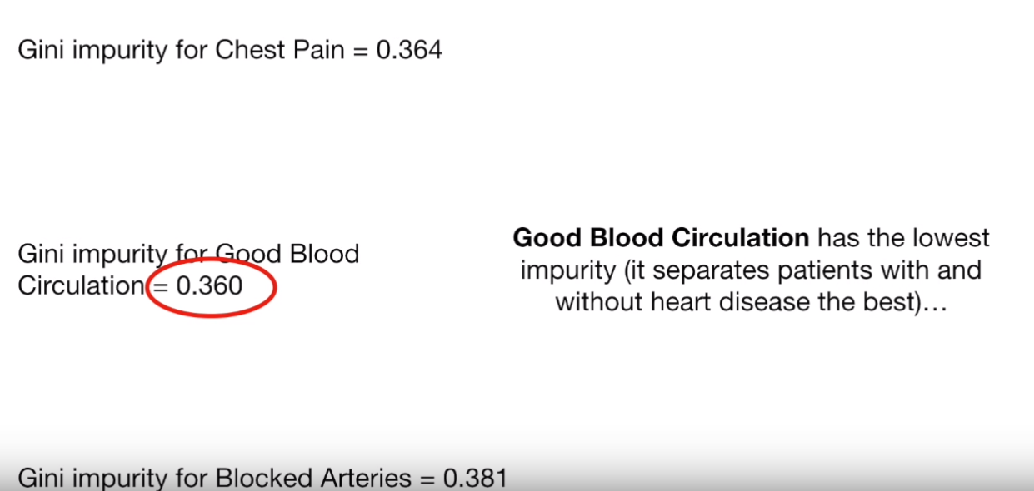
Building a Decision Tree

Slide 53
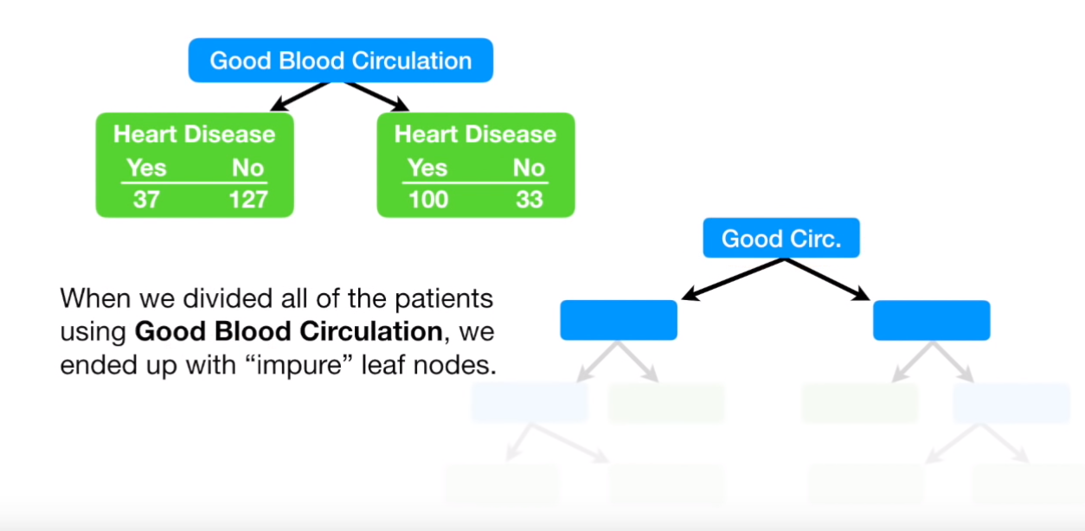
Building a Decision Tree

Slide 54

Building a Decision Tree

Slide 55

Building a Decision Tree

Slide 56

Building a Decision Tree

Slide 57

Building a Decision Tree

Slide 58

Building a Decision Tree

Slide 59

Building a Decision Tree

Slide 60

Building a Decision Tree

Slide 61

Building a Decision Tree

Slide 62

Building a Decision Tree

Slide 63

Building a Decision Tree

Slide 64

Building a Decision Tree

Slide 65

Building a Decision Tree
0.2

Slide 66

Building a Decision Tree

Slide 67

Building a Decision Tree

Slide 68

Building a Decision Tree

Slide 69

Building a Decision Tree

Slide 70

Building a Decision Tree

Slide 71

Building a Decision Tree

Slide 72

Building a Decision Tree

Slide 73

Building a Decision Tree

Slide 74

Building a Decision Tree

Slide 75

Building a Decision Tree

Slide 76

Building a Decision Tree

Slide 77

Building a Decision Tree

Slide 78

Building a Decision Tree

Slide 79


Building a Decision Tree

Slide 80

Building a Decision Tree

